Slide 1

软件工程专业英语
计算机科学学院
School of Computer Science
Unit 6：Implementing the System

Slide 2
Outline
Part 1, Dialogue: Creating High-Quality Code
Part 2, Translating: Computer Programming

Slide 3
Part 1, Dialogue: Creating High-Quality Code
Main content
主要讨论了实现高质量编码方面的问题。
采用面向对象编程
创建良好的接口
高质量的类内程序（routines/methods）
迭代开发
伪代码

Slide 4
Kevin: Before coding, I think it is necessary to conform to some principles during coding. With the help of these guidelines, we can be more reliable to create high-quality code and use the advantages of C# sufficiently, a popular object-oriented language which we have decided to use for coding.
conform to
顺从, 顺应; 遵守, 服从; 相一致, 相符合
1. He refused to conform to the local customs.
他拒绝遵从当地的风俗习惯。
2. The building does not conform to safety regulations.
这座建筑物不符合安全条例。
3. How can we deploy services that conform to this model?
我们将如何部署符合这个模型的服务？
Notes:
skeptical 英 [ˈskeptɪkl] 美 [ˈskeptɪkl] adj.怀疑的

Slide 5
Jason: For Object-Oriented Programming, programmers should think about programming in terms of classes, I think. A class is a collection of data and routines that share a cohesive, well-defined responsibility, and might also be a collection of routines that provides a cohesive set of services even if no common data is involved. A key to being an effective programmer is maximizing the portion of a program that you can safely ignore while working on any one section of code. Classes are the primary tool for accomplishing that objective.
cohesive [kəʊˈhiːsɪv] 有黏着力的;紧密结合的
cohesiveness 粘结性, 内聚性; 凝聚力
This use of interfaces and metadata in the manifest enforces loosely coupled yet tightly cohesive modules.
这些接口和清单中的元数据的使用强制实现了松散耦合但紧密聚合的模块。
Notes:
skeptical 英 [ˈskeptɪkl] 美 [ˈskeptɪkl] adj.怀疑的

Slide 6
Sharon: I absolutely agree with you. Furthermore, I think that the first and probably the most important step in creating a high-quality class is creating a good interface. This consists of creating a good abstraction for the interface to represent and ensure that the details remain hidden behind the abstraction. Particularly, in the analysis and design phase of our system, we have already identified all the classes, and defined the attributes and operation relevant for each of them. Now, we should review and modify the classes with these criteria, which should be held constant when coding all of them.
consist in sth 存在于；在于 consist of sth 由…组成（或构成）
1. The true wealth does not consist in what we have, but in what we are.
真正的财富不在于我们拥有什么，而在于我们的人格。
2. The test page can consist entirely of code; it does not need to contain controls.
测试页可完全由代码组成；不需要包含控件。
Notes:
skeptical 英 [ˈskeptɪkl] 美 [ˈskeptɪkl] adj.怀疑的

Slide 7
Kevin: Yes. In addition, another important factor is high-quality routines within the classes. The routine makes programs easier to read and understand than any other feature of any programming language, and is also the greatest technique ever invented for saving space and improving performance, I think. Imagine how much larger our code would be if we had to repeat the code for every call to a routine instead of branching to the routine. Imagine how harder it would be to make performance improvements in the same code used in a dozen places instead of making them all in one routine. Once we've identified the class's major routines in the first step, we must construct each specific routine. Construction of each routine typically unearths the need for additional routines, both minor and major, and issues arising from creating those additional routines often ripple back to the overall class design.
unearth 发现, 发掘; 揭露
I had to unearth the problem and I was looking for a way to explain it.
我必须要挖掘出问题所在，而且我试图找到解释。
Notes:
skeptical 英 [ˈskeptɪkl] 美 [ˈskeptɪkl] adj.怀疑的

Slide 8
Jason: So constructing classes and constructing routines tends to be an iterative process.
Kevin: That's right. In every iterative process, we will test each routine as it's created. After the class as a whole becomes operational, we will review and test the class as a whole for any issues that can't be tested at the individual-routine level. And at each step, we should check our work and encourage others to check it too. In that way, we'll catch mistakes at the least expensive level, when we've invested the least amount of effort.
Sharon: Besides, the Pseudocode Programming Process is a useful tool for detailed design and makes coding easy. Pseudocode can be translated directly into comments, ensuring that the comments are accurate and useful.
Notes:
skeptical 英 [ˈskeptɪkl] 美 [ˈskeptɪkl] adj.怀疑的

Slide 9
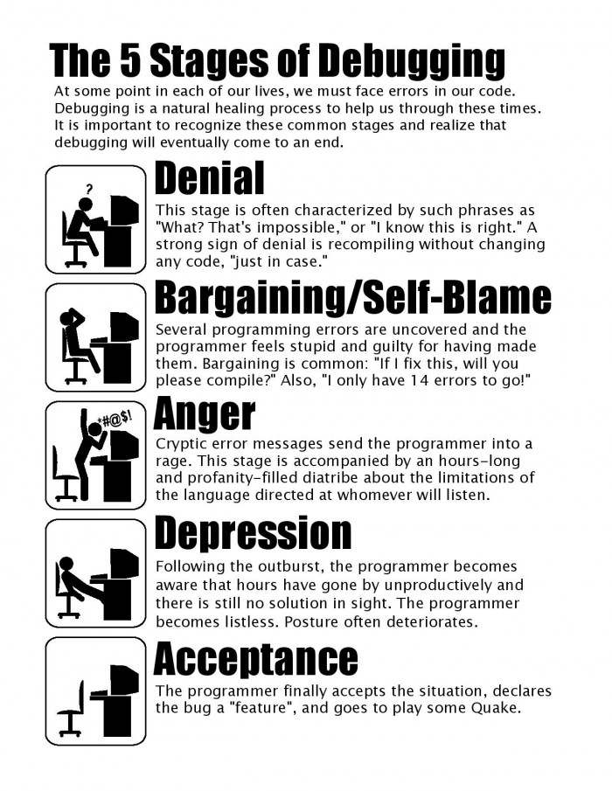

Slide 10
Outline
Part 1, Dialogue: Creating High-Quality Code
Part 2, Translating: Computer Programming

Slide 11
The 1st & 2nd paragraph
A program is a list of instructions that the computer must follow to process data into information. The instructions consist of statements used in a programming language, such as Basic. Examples are programs that do word processing, desktop publishing, or payroll (工资) processing. Programming is a five-step process for creating that lists of instructions as follows:
1. The problem clarification (definition) step consists of six mini-steps—clarifying program objectives and users, outputs, inputs, and processing tasks; studying the feasibility of the program; and documenting the analysis.
instruction 指令，命令
statement 语句
clarification 声明
definition 定义

Slide 12
The 3rd paragraph
2. To design the solution, one first needs to create an algorithm. An algorithm is a formula or sets of steps for solving a particular problem. In the program design step, the software is designed in two mini-steps. First, the program logic is determined through a top-down approach and modularization, using a hierarchy chart (or structure chart). Then it is designed in detail, either in narrative form, using pseudocode, or graphically, using flowcharts. Pseudocode is a method of designing a program using normal human-language statements to describe the logic and the processing flow. Most programmers use a design approach called structured programming. Structured programming takes a top-down approach that breaks programs into modular forms. In structured program design, three control structures are used to form the logic of a program: sequence, selection, and iteration (or loop).
pseudocode 伪代码
flowchart 流程图
control structure
sequence, selection, iteration/loop

Slide 13
The 4th paragraph
3. Once the design has been developed, the actual writing of the program begins. Wring the program is called coding. Coding is what many people think of when they think of programming, although it is only one of the five steps. Coding consists of translating the logic requirements from pseudocode or flowcharts into a programming language—the letters, numbers, and symbols that make up the program. A programming language is a set of rules that tells the computer what operations to do. Examples of well-known programming languages are C, C++, and Java. These are called high-level languages.

Slide 14
The 5th paragraph
4. Program testing involves running various tests and then running real-world data to make sure the program works. Two principal activities are desk-checking and debugging. These steps are called alpha testing. Desk-checking is simply reading through, or checking, the program to make sure that it’s free of errors and that the logic works. Once the program has been desk-checked, further errors, or “bugs” will doubtless surface. To debug means to detect, locate, and remove all errors in a computer program. Mistakes may be syntax errors or logical errors. Syntax errors are caused by typographical ([ˌtaɪpəˈɡræfɪkl]排字上的;印刷上的) errors and incorrect use of the programming language. Logic errors are caused by incorrect use of control structures. After desk-checking and debugging, the program may run fine—in the laboratory. However, it needs to be tested with real data; this is called beta testing.

Slide 15
The 6th paragraph
5. Writing the program documentation is the fifth step in programming. The resulting documentation consists of written descriptions of what a program is and how to use it. Documentation is not just an end-stage process of programming. It has been (or should have been) going on throughout all programming steps. Documentation consists of user documentation, operator documentation, programmer documentation, and it can be used to maintain the program.

Slide 16
The 7th paragraph
Programming languages have five generations. The births of the generations are as follows:
(1) First generation, 1945—machine language
(2) Second generation, mid-1950s—assembly language
(3) Third generation, mid-1950s to early 1960s—high-level languages (procedural languages and object-oriented); for example, Fortran, COBOL, BASIC, C, and C++
(4) Fourth generation, early 1970s—very high-high-level languages (problem-oriented languages ); for example, SQL, Intellect, NOMAD, FOCUS
(5) Fifth generation, early 1980s-natural languages

Slide 17
The 8th paragraph
A compiler is a language-translator program that converts the entire program of high-level language into machine language before the computer executes the program. Examples of procedural languages using compilers are COBOL, FORTRAN, Pascal, and C. An interpreter is a language-translator program that converts each procedural language statement into machine language and executes it immediately, statement by statement. BASIC is a procedural language using an interpreter. When a compiler is used, it requires two steps (the source code and the object code) before the program can be executed. The interpreter, on the other hand, requires only one step. The advantage of a compiler language is that, once you have obtained the object code, the program executes faster. The advantage of an interpreter language, on the other hand, is that programs are easier to develop. Some language translators—such as those with C++ and Java—can both compile and interpret.

Slide 18
The 9th paragraph
In object-oriented programming, data and the instructions for processing that data are combined into a self-sufficient “object" that can be used in other programs. An object is a self-contained module consisting of preassembled programming code. Send the “message" when an object's data is to be processed. A message is an alert sent to the object when an operation involving that object needs to be performed. The message needs only to identify the operation. How it is actually to be performed is embedded within the processing instructions that are part of the object. These processing instructions within the object are called the methods.
self-contained 独立的; 自给自足的; 设备齐全的
Services are designed as self-contained modules that can be advertised, discovered, composed, and negotiated on demand.
服务被设计为自包含的模块，可按需要进行广告、发现、组合和协商。

Slide 19
The 10th paragraph
Object-oriented programming has three important concepts, which go under the jaw-breaking (难发音的) names of encapsulation, inheritance, and polymorphism. Encapsulation means an object contains (encapsulates) both data and relevant processing instructions. Once an object has been created, it can be reused in other programs. An object's uses can also be extended through concepts of class and inheritance. All objects that are derived from or related to one another are said to form a class. Each class contains specific instructions (methods) that are unique to that group. Inheritance is the method of passing down traits (特性，特点) of an object from classes to subclasses in the hierarchy. Thus, new objects can be created by inheriting traits from existing classes. Polymorphism means that a message (generalized request) produces different results based on the object that it is sent to.
encapsulation 封装 inheritance 继承 polymorphism 多态

Slide 20
The 11th paragraph
Examples of object-oriented programming languages are C++ & Java, C++—the plus sign stands for “more than C"—combines the traditional C programming language with object-oriented capability. C++ was created by Bjarne Stroustrup. With C++, programmers can write standard code in C without the object-oriented features, use object-oriented features, or do a mixture of both. A high-level programming language developed by Sun Microsystems in 1995, Java is used to write compact programs that can be downloaded over the Internet and immediately executed on many kinds of computers. Java is similar to C++ but is simplified to eliminate language features that cause common programming errors.

Slide 21
The 12th paragraph
A markup language is a kind of coding, or “tags,” inserted into text that embeds details about the structure and appearance of the text. HTML (Hyper‘ Text Markup Language) is a markup language that lets people create on-screen documents (屏幕显示文档) for the Internet that can easily be linked by words and pictures to other documents. VRML (Virtual Reality Modeling [or Markup] Language) is a type of programming language used to create three-dimensional Web pages including interactive animation [ˌænɪˈmeɪʃn]. XML (Extensible Markup Language) is a metalanguage (a language used to define another language) written in SGML that allows one to facilitate the easy interchange of documents on the Internet.
facilitate [fəˈsɪlɪteɪt] v. 帮助; 促进; 促使; 使便利
These wrappers provide the logic to facilitate federated object registration and communication with the data source.
这些包装器提供了促进联邦对象注册和与数据源之间的通信的逻辑。

Slide 22
The last paragraph
A script is a short list of self-executing commands embedded in a Web page that perform a specific function or routine. JavaScript is a popular object-oriented scripting language that is widely supported in Web browsers. It adds interactive functions to HTML pages, which are otherwise static. ActiveX is a set of control, or reusable components, that enable programs or content of almost any type to be embedded within a Web page. Perl (Practical Extraction and Report Language) is a general-purpose programming language developed for text manipulation and now used for Web development, network programming, system administration, GUI development, and other tasks.

